Slide 1
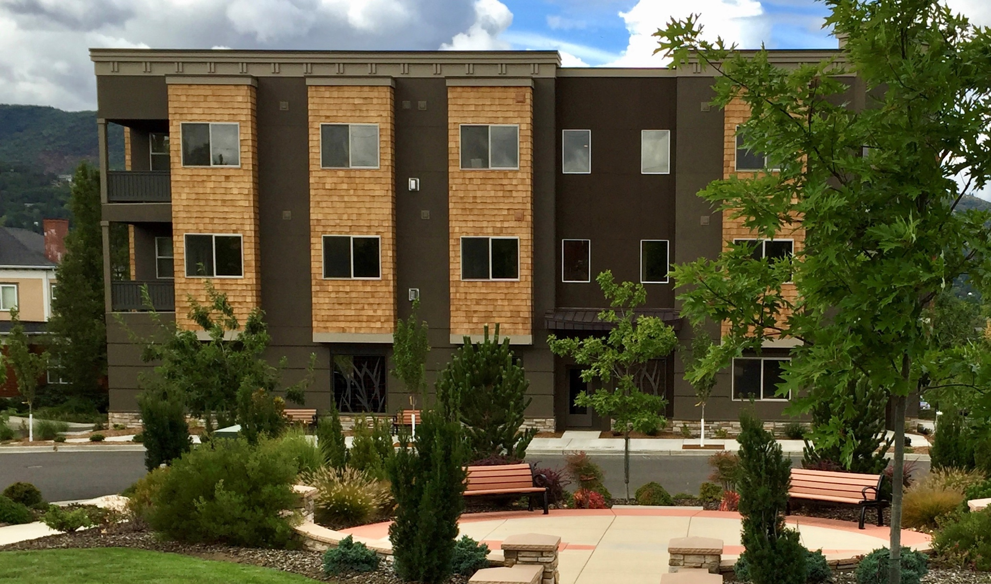
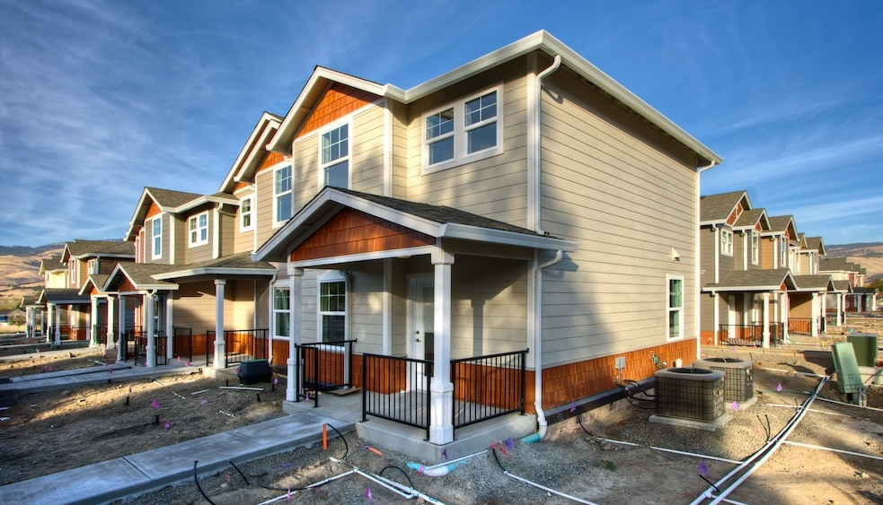
Ashland: Housing Production Strategy
Open House Meeting
October 19, 2022

Slide 2
Housing Development and Affordability is Important to Ashland
Build on Ashland’s efforts to meet the city’s housing needs
  Housing Capacity Analysis (2021)
  Comprehensive Plan and Housing Element Update (2019)
  Ashland Consolidated Plan 2020-2024
  Affordable Housing Ordinance
  Rent Burden Meeting (2020)
  Missing Middle Code Update (on-going)
The City was given a grant by DLCD to complete the HPS
Cost Burden by Tenure, Ashland, 2014-2018
Source: U.S. Census, American Community Survey 2014-2018

Slide 3
Cost Burden by Tenure and Income, 2015-2019
Cost Burden by Income for Renter Households, Ashland, 2015-2019
Cost Burden by Income for Owner Households, Ashland, 2015-2019
Source: U.S. Census, American Community Survey 2015-2019
Notes:
Discuss why we focus on lower income levels (less than 50%), but also discuss the needs of those up to 80% MFI who are increasingly struggling to afford housing.

Slide 4
A Housing Production Strategy is an 8 Year Action Plan
Housing Need: What is Ashland’s future housing need
Develop strategies to meet future housing need
Evaluation of all strategies to achieve fair and equitable housing outcomes
Stakeholder engagement, especially of protected classes
Housing Production Strategy Report with policies or actions that Ashland will implement

Slide 5
Housing Need in Ashland

Slide 6
What is Housing Need?
Housing that is affordable based on income
  Access to housing where housing costs are less than 30% of a households’ gross income
    HUD standard that does not account for wealth, debts, special costs
Access to housing that meets the unique needs of a household
  Size and household composition
  Location relative to work and school, ”high opportunity” areas
  Characteristics of unit and neighborhood
  Access without discrimination (Fair Housing)

Slide 7
Financially Attainable Housing
HUD’s Median Family Income (MFI) for Jackson County in 2020 is $73,100
Median Home Sale Price in Ashland:
$549,900
A household would need to earn $140,000 (192% of MFI) to afford this price.
Average Asking Rent in Ashland:
$1,550
A household would need to earn about $62,000 or 85% of MFI to afford this rent for a 2-bedroom unit.
Source: U.S. Department of Housing and Urban Development, Jackson County, 2021. Oregon Employment Department.

Slide 8
Share of Households by Income Level, Ashland
This chart is based on the HUD MFI for Jackson County and the ACS household income distribution for Ashland.
Publicly Subsidized Affordable
0%-60% MFI
Middle Income
60%-120% MFI
Market Rate
120%+ MFI
Source: U.S. Census Bureau, ACS 2015-2019, Table B19001; HUD, FY 2021 MFI.

Slide 9
Housing Needs Often Differ by Group
Point-in-Time Homelessness Estimates, Jackson County, 2017-2021
People experiencing homelessness:
  Temporarily or chronically
  Alone or with children
  Ashland: about 10% of Jackson County’s population of people experiencing homelessness
Racial or ethnic groups
People over 65 years old
People with disabilities
831
679
712
Source: Oregon Housing and Community Services.
Note: OHCS reported two counts in 2021 – estimated and reported counts. This is the estimated counts.

Slide 10
Strategies to Accommodate Housing Need in Ashland

Slide 11
Existing Policies to Address Ashland Housing Needs
Affordable Housing Programs:
Reduced / Waived Building Permit fee, Planning fees, or SDCs
Density Bonuses
Affordable Housing Trust Fund
CDBG funds
Land Trusts
Public Land Disposition
Parcel assembly
Inclusionary zoning for annexations/ certain zone changes
Tenant Rights (Ordinance 2939)
Market-rate Housing Programs:
Middle housing code
ADU code update – removed barriers
Live-Work housing or Mixed-use housing in commercial zones
Zoning provisions to encourage density
SDC Financing Credits
Vertical Housing Tax Credit

Slide 12
What is a city’s role housing development?
Policy—including zoning, density, and design requirements– must allow developer to build a profitable project.
Public Policy
Capital
Land
Market Feasibility
Cities can directly influence public policy, land, and infrastructure.
Cities may have limited influence on market feasibility
There must be sufficient demand (rents, sales prices) to support a profitable project
Development
Can Occur
Developer must
control the site with
reasonable acquisition costs
Developer must be able to access resources for investment (e.g., equity investment, bank loans)

Slide 13
Strategies the City is considering
Participate in or establish a land bank.
Participate in a land trust.
Host educational events with the Housing and Human Services Commission or other organizations.
Develop an equitable housing plan.
Maintain quality and support preservation of existing manufactured home parks and support development of new manufactured home parks.
Work with partners to support development of additional permanent supportive housing.
Implement the Multiple Unit Property Tax Exemption (MUPTE) to support multifamily or affordable housing.
Preserve and improve existing low-cost, unregulated, rental housing.
Disallow single family dwellings in High Density R-3 Zone, outside of Historic areas.
Increase development capacity of multifamily dwellings through changes to the Land Use Ordinance.
Evaluate opportunities to improve energy efficiency and reduce greenhouse gas emissions during housing development.
Funding Sources
Establish a Construction Excise Tax
Evaluate using Urban Renewal
Identify additional funds to support the Affordable Housing Trust Fund

Slide 14
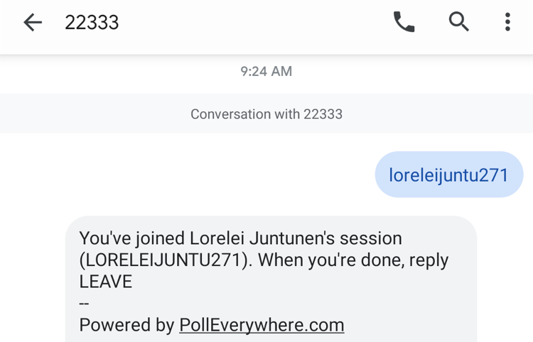
Provide your input!
Join the activity by texting to number 22333 the word LORELEIJ845

Slide 15
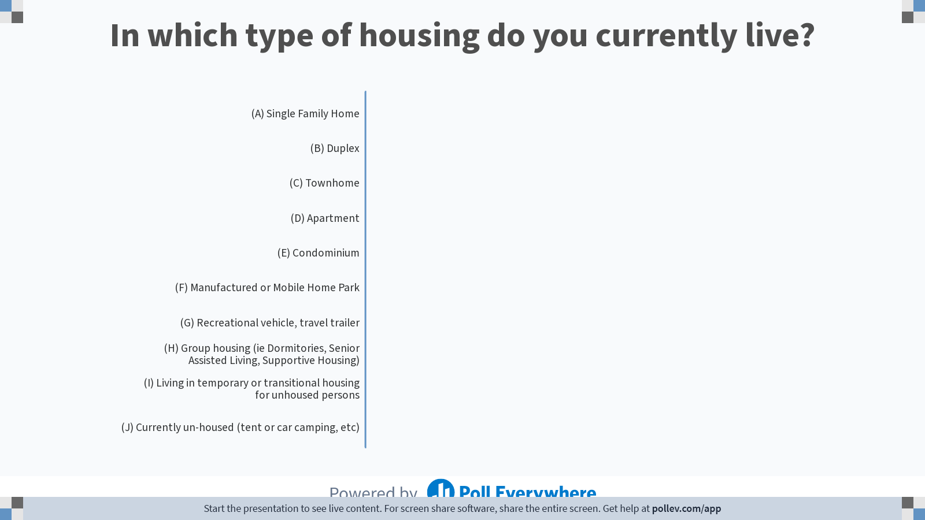
Notes:
Do not modify the notes in this section to avoid tampering with the Poll Everywhere activity.
More info at polleverywhere.com/support
In which type of housing do you currently live?
https://www.polleverywhere.com/multiple_choice_polls/cYeEDEPSbSvRjecPynBgg

Slide 16
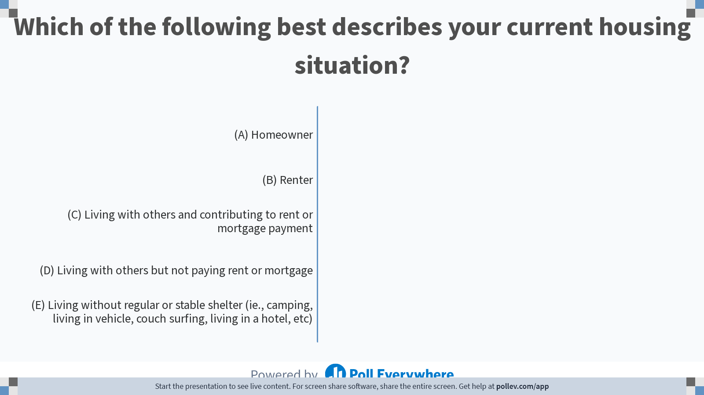
Notes:
Do not modify the notes in this section to avoid tampering with the Poll Everywhere activity.
More info at polleverywhere.com/support
Which of the following best describes your current housing situation?
https://www.polleverywhere.com/multiple_choice_polls/6XGJG1GrMuLUgOqXvfdag

Slide 17
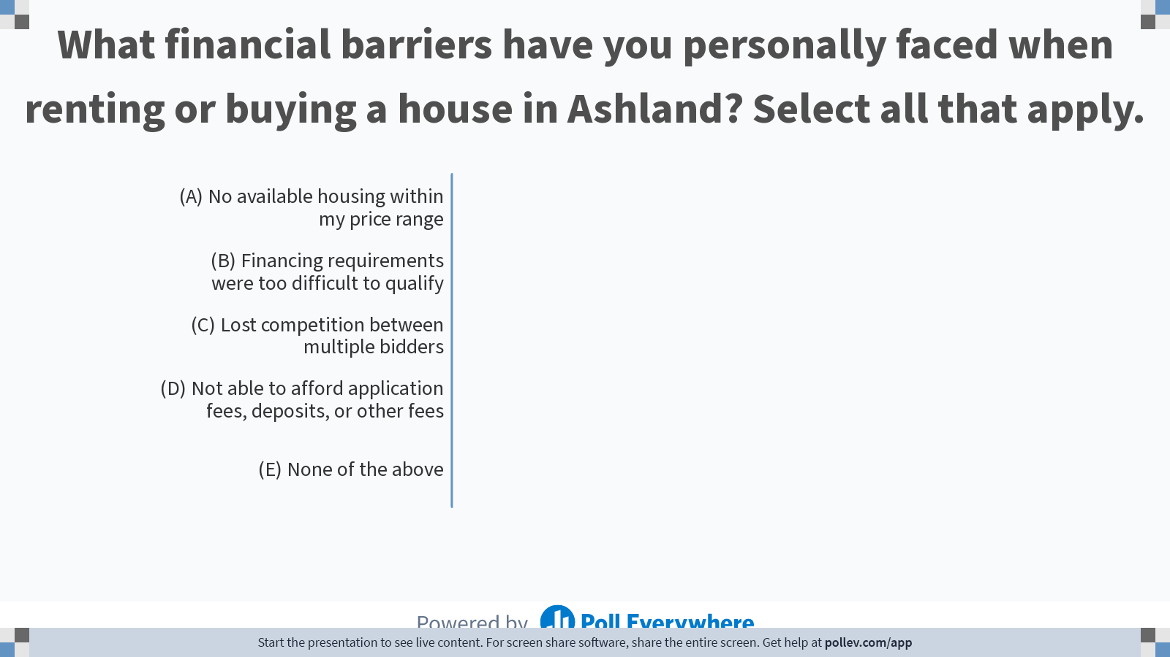
Notes:
Do not modify the notes in this section to avoid tampering with the Poll Everywhere activity.
More info at polleverywhere.com/support
What financial barriers have you personally faced when renting or buying a house in Ashland? Select all that apply.
https://www.polleverywhere.com/multiple_choice_polls/mCqLbl8UoY68BlehqwrwH

Slide 18
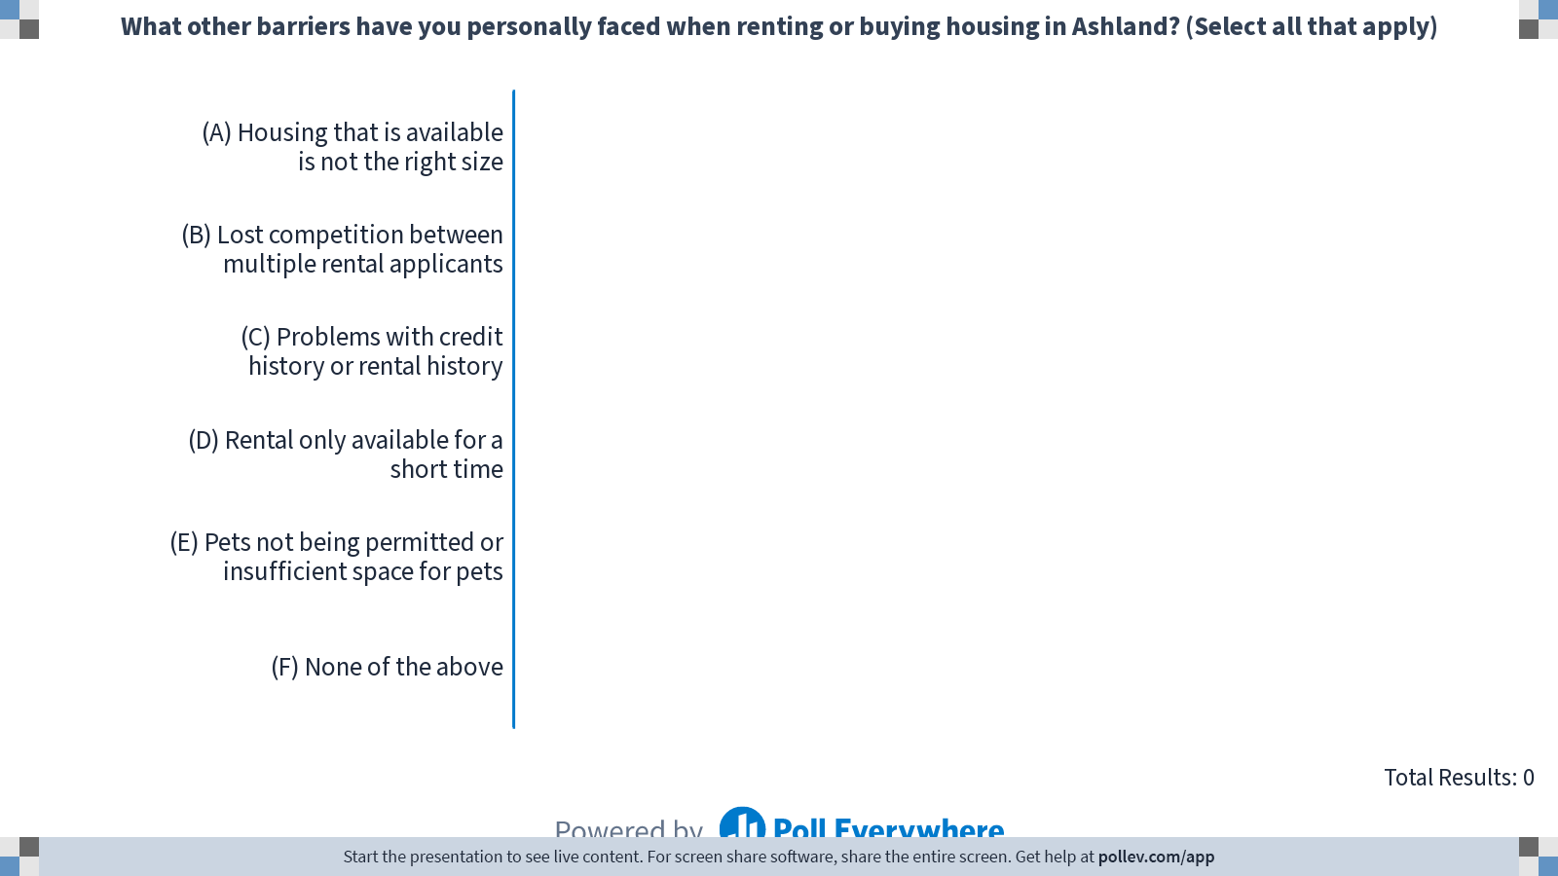
Notes:
Do not modify the notes in this section to avoid tampering with the Poll Everywhere activity.
More info at polleverywhere.com/support
What other barriers have you personally faced when renting or buying housing in Ashland? (Select all that apply)
https://www.polleverywhere.com/multiple_choice_polls/UNs73CgM9D20ooA40IknE

Slide 19
For the next six questions, please rate how important you think it is for the City to focus on each of the following categories:

Slide 20
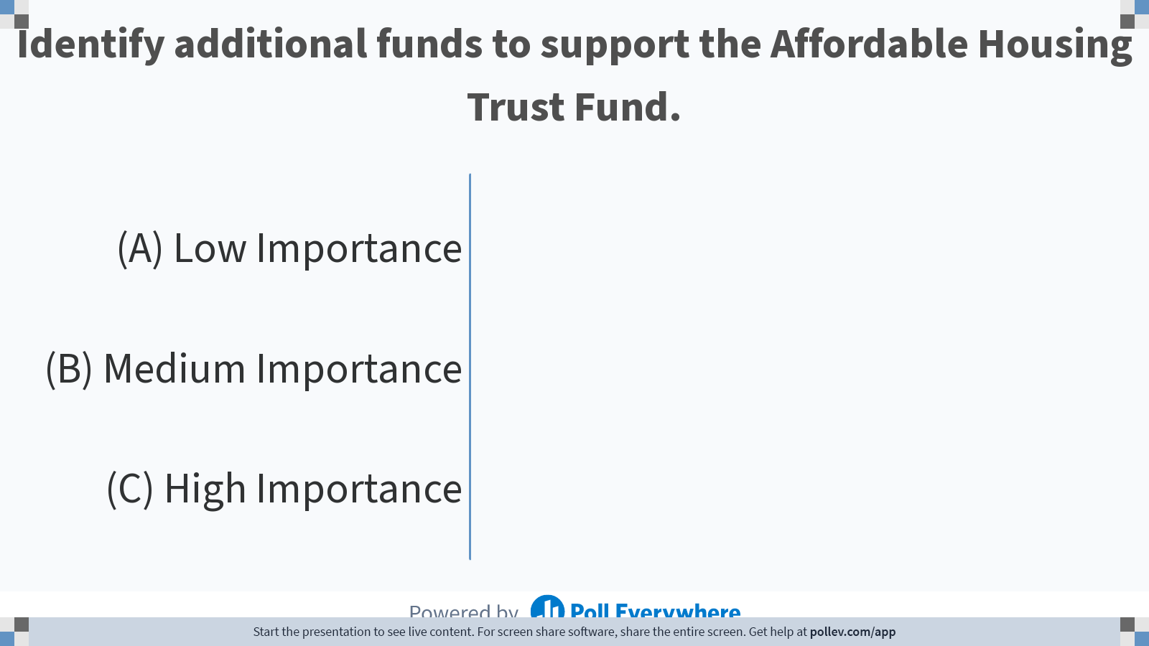
Notes:
Do not modify the notes in this section to avoid tampering with the Poll Everywhere activity.
More info at polleverywhere.com/support
Identify additional funds to support the Affordable Housing Trust Fund.
https://www.polleverywhere.com/multiple_choice_polls/kpJSd7CG65CmFDnP4ku4t

Slide 21
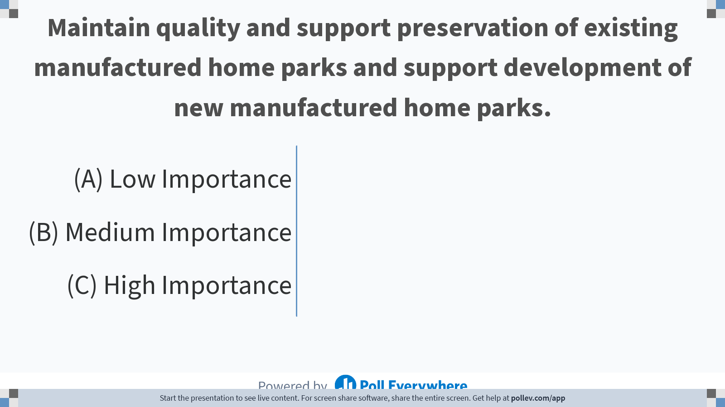
Notes:
Do not modify the notes in this section to avoid tampering with the Poll Everywhere activity.
More info at polleverywhere.com/support
Maintain quality and support preservation of existing manufactured home parks and support development of new manufactured home parks.
https://www.polleverywhere.com/multiple_choice_polls/eUjuYvqJWqbtwtYGZQOhM

Slide 22
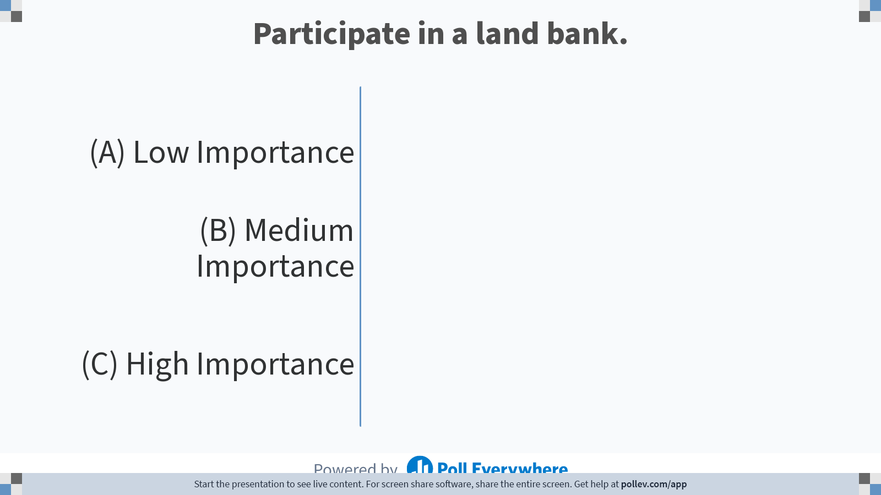
Notes:
Do not modify the notes in this section to avoid tampering with the Poll Everywhere activity.
More info at polleverywhere.com/support
Participate in a land bank.
https://www.polleverywhere.com/multiple_choice_polls/cxOznt9RDm319KIetveH5

Slide 23
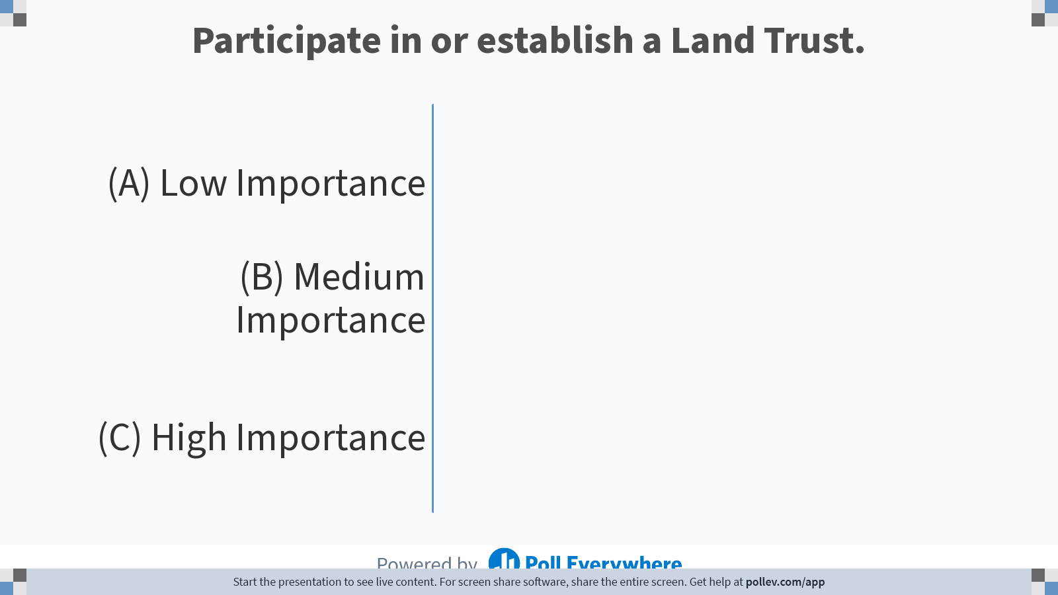
Notes:
Do not modify the notes in this section to avoid tampering with the Poll Everywhere activity.
More info at polleverywhere.com/support
Participate in or establish a Land Trust.
https://www.polleverywhere.com/multiple_choice_polls/Sy8ZslSjnhXJiV8sVPBNo

Slide 24
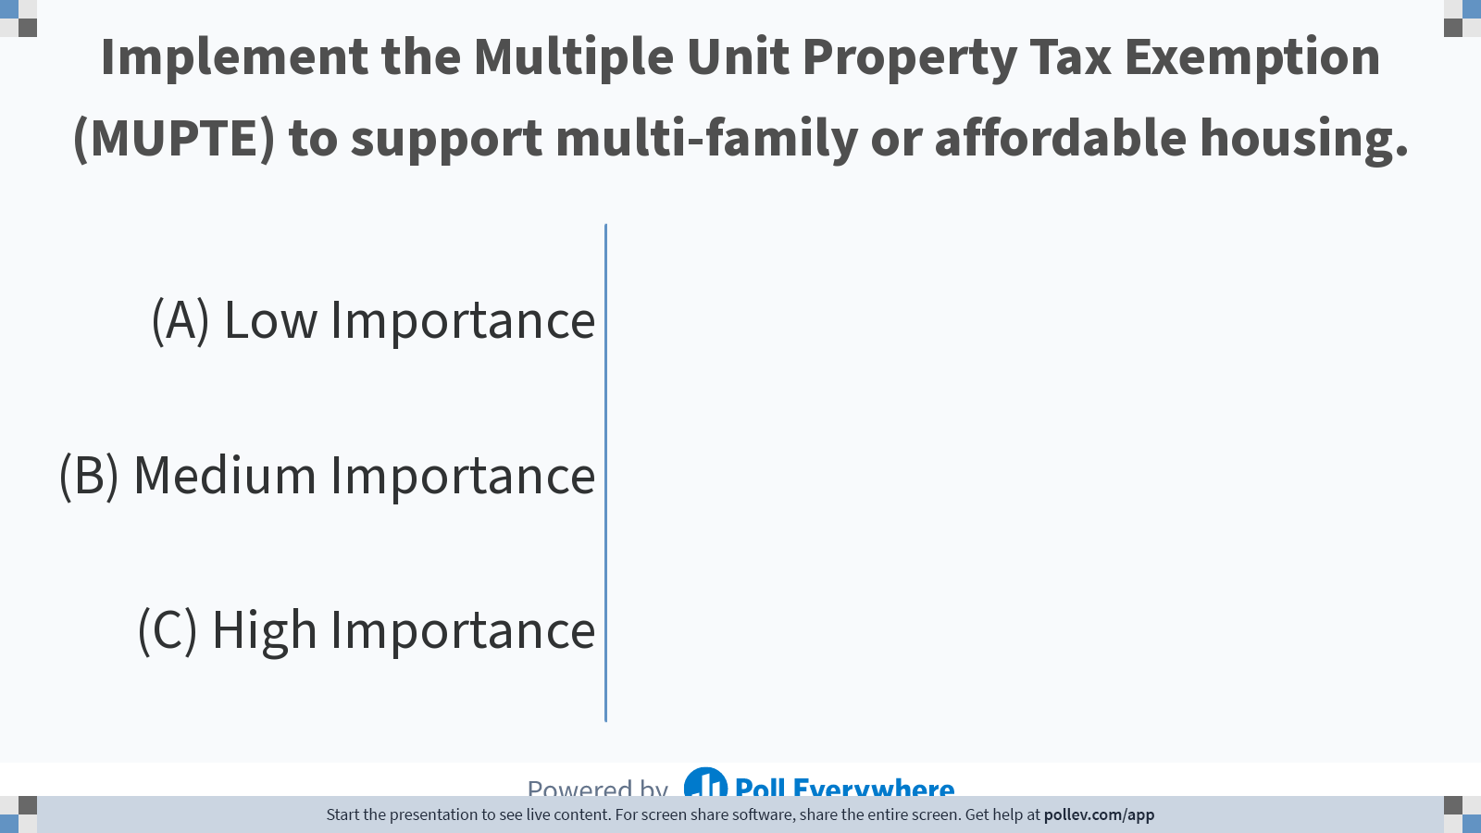
Notes:
Do not modify the notes in this section to avoid tampering with the Poll Everywhere activity.
More info at polleverywhere.com/support
Implement the Multiple Unit Property Tax Exemption (MUPTE) to support multi-family or affordable housing.
https://www.polleverywhere.com/multiple_choice_polls/N9GyncEJe43fsfpDQra5l

Slide 25
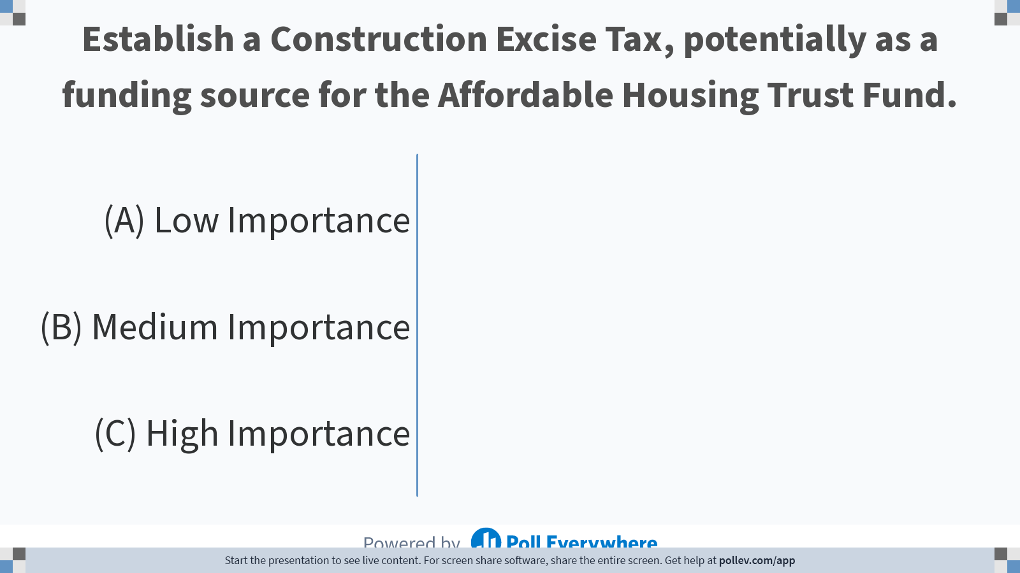
Notes:
Do not modify the notes in this section to avoid tampering with the Poll Everywhere activity.
More info at polleverywhere.com/support
Establish a Construction Excise Tax, potentially as a funding source for the Affordable Housing Trust Fund.
https://www.polleverywhere.com/multiple_choice_polls/x0kVgmBefLGjWJQwLdGWa

Slide 26
Ashland Community Questionnaire results
The City hosted an online survey open to all Ashland residents.
The purpose was to ask residents about their views on some of the actions the City might take to expand the range of housing options.
Survey was open August 24th – October 14th 2022
236 people responded
82% of respondents agreed that housing price was the biggest housing problem in Ashland.

Slide 27
Ashland Community Questionnaire results (cont.)
At least half of respondents thought these strategies would make a significant positive difference:
  Support using city-owned land for the construction of affordable housing.
  Support and fund non-profit organizations who build new housing that people of varied income levels can afford.
  Support and fund organizations that serve un-housed populations and help houseless people get into more stable housing; for example more units of supportive housing.
  Create policy that supports the construction different types of homes and broadens what is acceptable as a “dwelling unit:” Examples: cottages, accessory dwelling units, duplexes, triplexes, manufactured home parks, tiny homes, 3D printed homes, domes, repurposed cargo containers, etc.
  Limit the number of vacation rentals as well as limiting the converting existing housing into vacation rentals.
  Require private developers to include a percentage of affordable housing units in projects that would contain more than 20 dwelling units, referred to as “Inclusionary zoning”.
Included as strategy in the HPS
Included as recommendation in the HPS

Slide 28
Strategies the City is considering
Participate in or establish a land bank.
Participate in a land trust.
Host educational events with the Housing and Human Services Commission or other organizations.
Develop an equitable housing plan.
Maintain quality and support preservation of existing manufactured home parks and support development of new manufactured home parks.
Work with partners to support development of additional permanent supportive housing.
Implement the Multiple Unit Property Tax Exemption (MUPTE) to support multifamily or affordable housing.
Preserve and improve existing low-cost, unregulated, rental housing.
Disallow single family dwellings in High Density R-3 Zone, outside of Historic areas.
Increase development capacity of multifamily dwellings through changes to the Land Use Ordinance.
Evaluate opportunities to improve energy efficiency and reduce greenhouse gas emissions during housing development.
Funding Sources
Establish a Construction Excise Tax
Evaluate using Urban Renewal
Identify additional funds to support the Affordable Housing Trust Fund

Slide 29
Discussion
Are we missing approaches to addressing the need for development of housing and development of affordable housing?

Slide 30
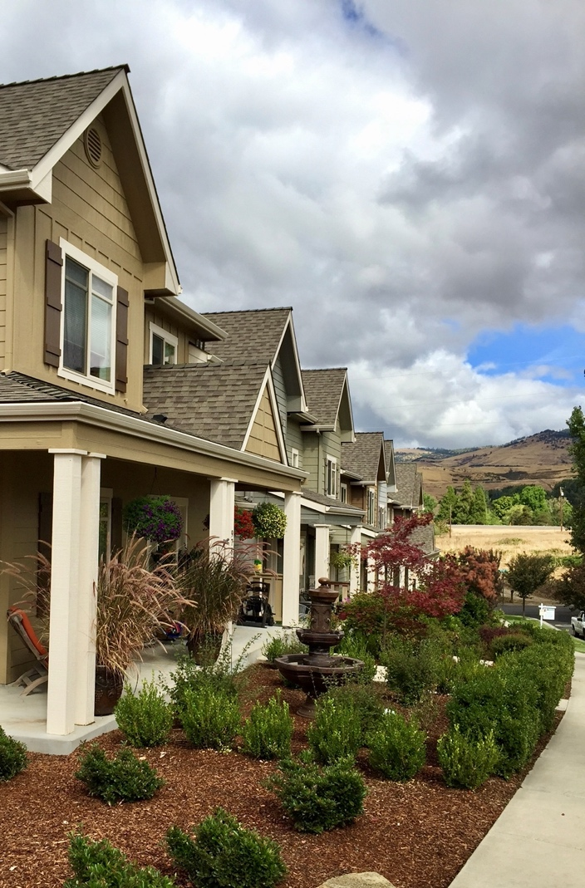
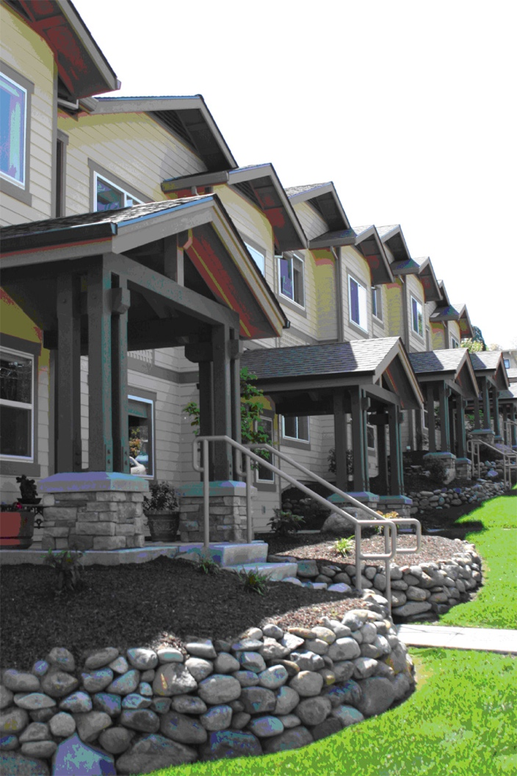
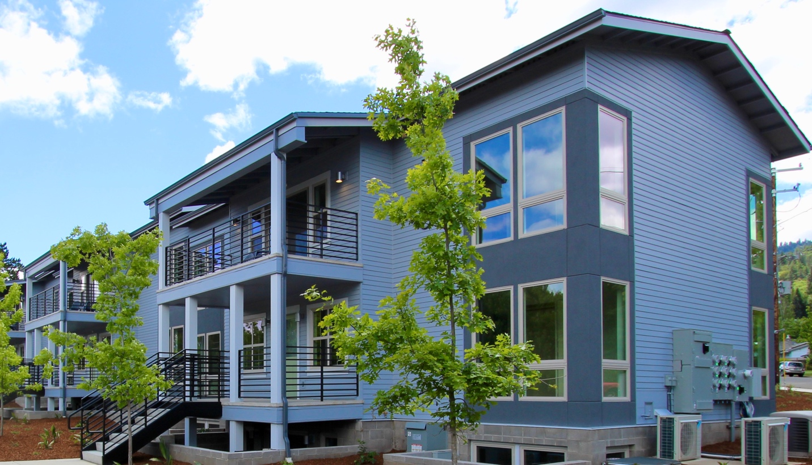
Next Steps
ECONorthwest will work on preparing the full draft Housing Production Strategy
Next Advisory Committee Meeting: 1/23
Presentation to the Housing & Human Services Commission: 2/23
Planning Commission work session: 2/28

