Slide 1
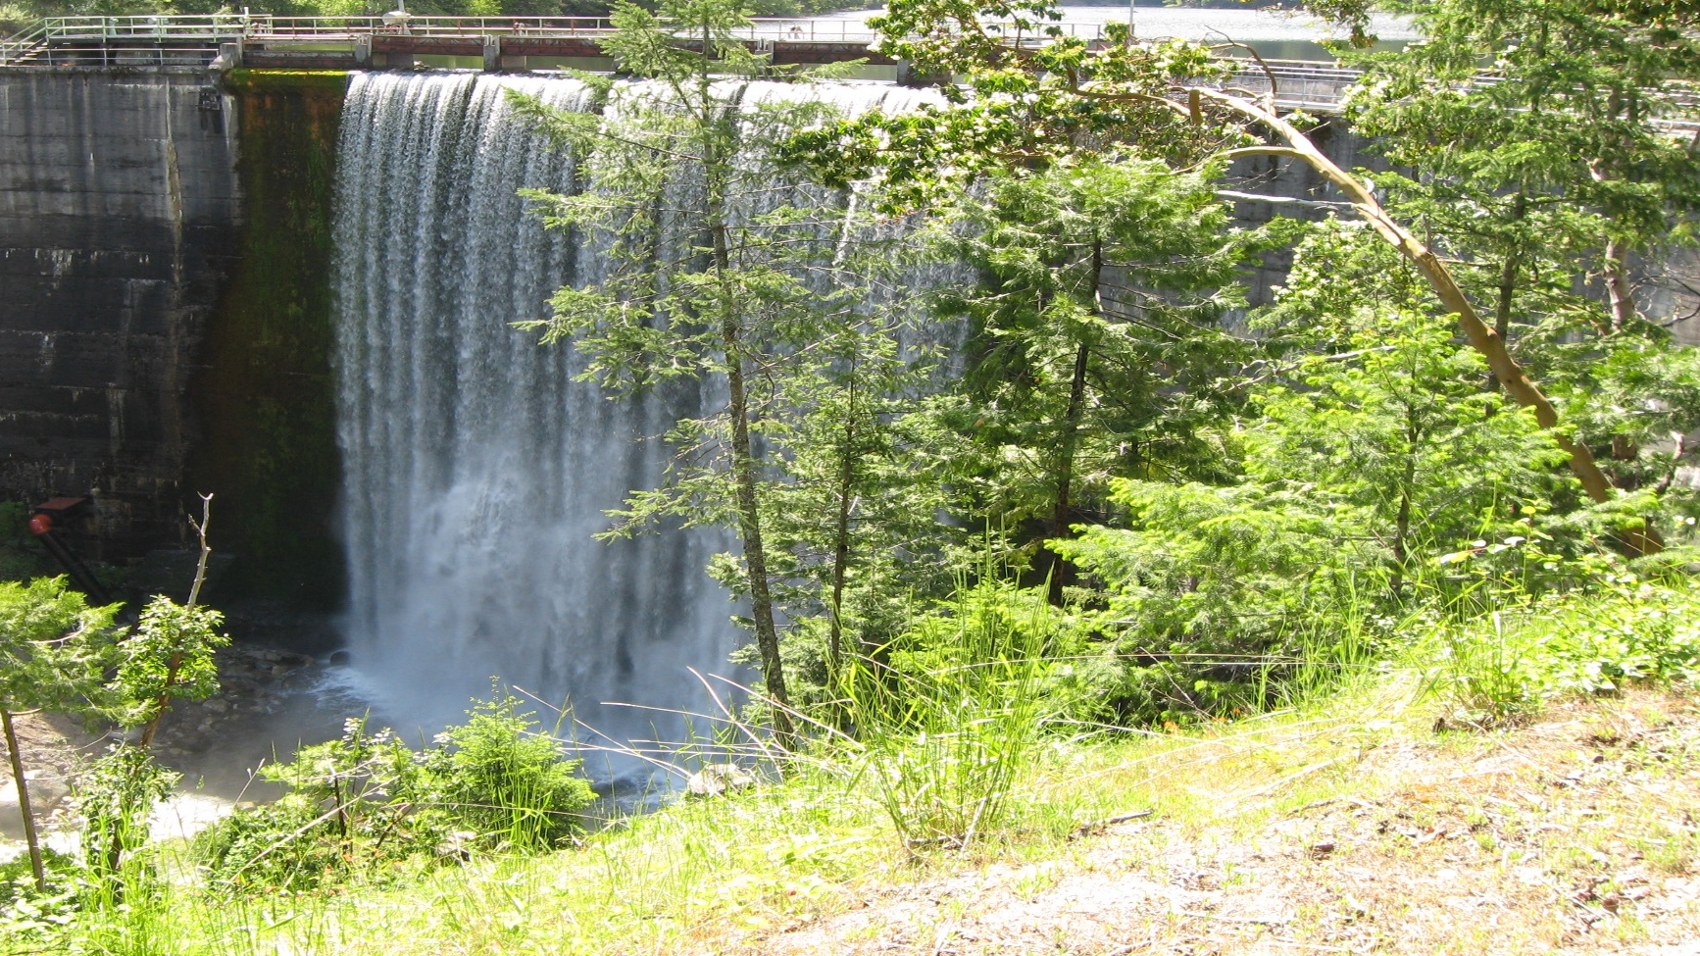

City of Ashland
Water Resources 2022

Slide 2
Water Sources
Reeder Reservoir
  800 Acre feet (260 MG)
    East & West Forks
      2 MGD to 20+ MGD Daily Supply
      Snowpack Driven
Reeder Reservoir - Current
  93.2% full
  1.88 MGD Production
  East & West Forks Supply
      9.7 MGD/Day

Slide 3
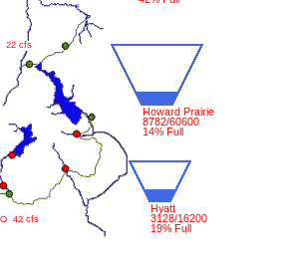
Water Sources
Talent Irrigation District (TID)
  1369 Acre-Feet (446 MG) of Water Right
  Available May-October
  Delivered from Howard Prairie and Hyatt Lakes through the canal System to Ashland
    Can be used as a supplemental source for Treated Water
    Pumped to Water Treatment Plant
Expect diminished irrigation season
Not connected to Emigrant Lake
Current Lake Storage Volumes

Slide 4
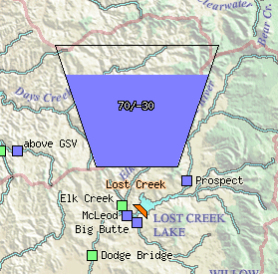
Water Sources
Talent – Ashland – Phoenix Intertie (TAP)
  1000 Acre-Feet (325 MG) of Water Rights
    2.13 MGD Capacity
    Available Year Round
    Delivered from Medford Water Commission through the TAP System
    Fully Treated Water
Lost Creek Lake Current Storage Volume

Slide 5
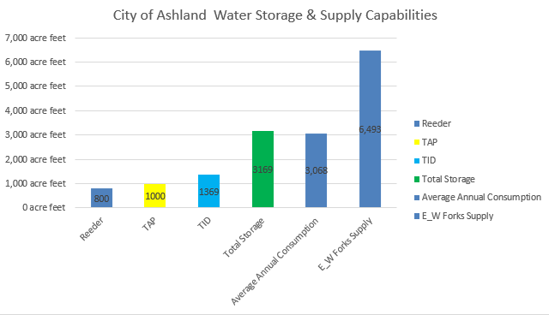
Water Supply – All Sources

Slide 6
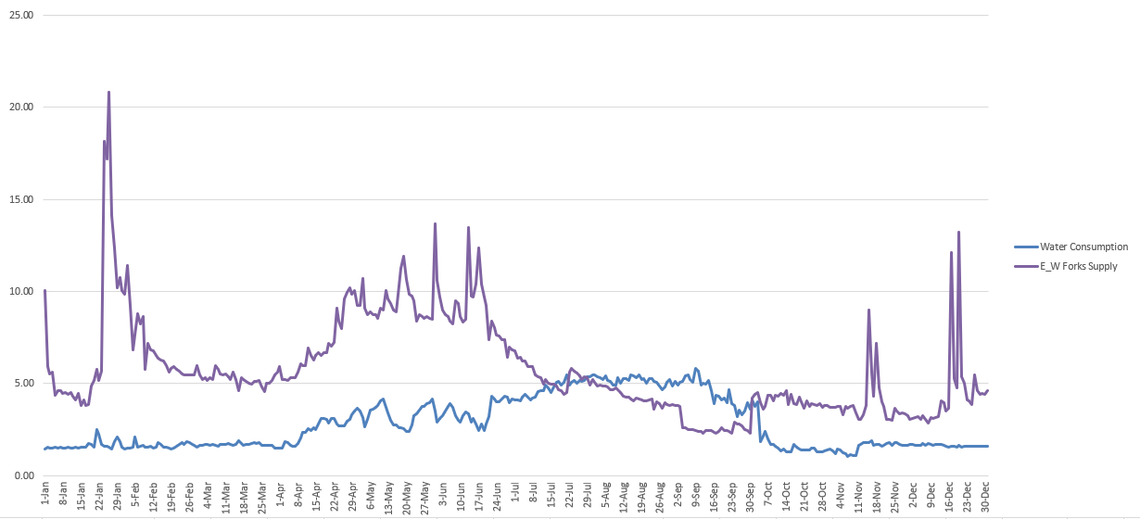
Water Consumption
Primary Reeder Supply
Supplemental Water Addition
TID Stop
TAP Addition

Slide 7
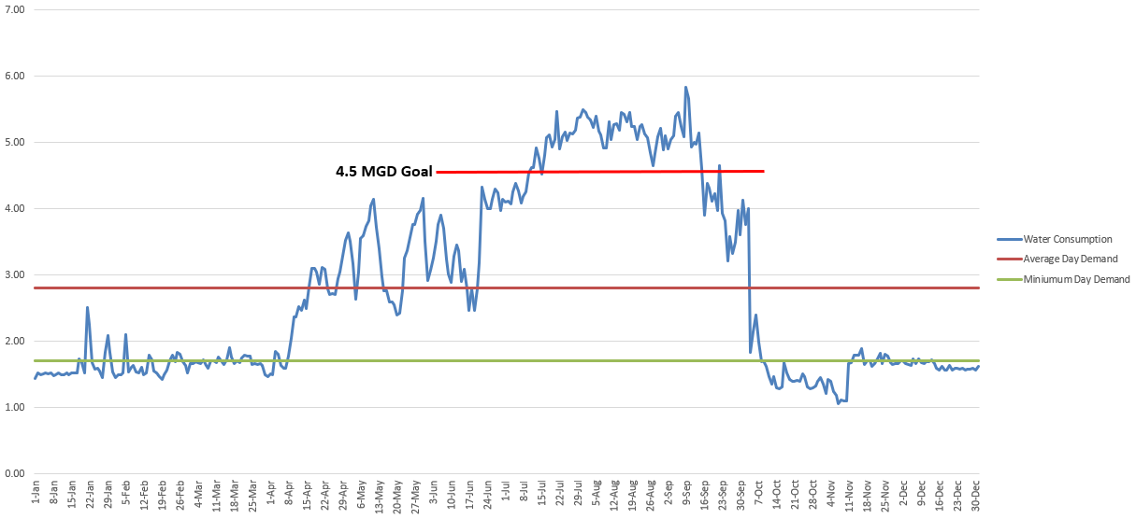
Water Consumption

Slide 8
Water Management Strategy
2022 Expectations
  Snowpack 62% of 30-year median
  TID Limited for Irrigation only & Shortened Season
  No Expected Reductions from TAP Supply
Conservation – long term reduction strategy
  Conservation Protects Supply
  Use Reeder Source year round
  Supplement with additional sources as necessary
    TID first if available
    TAP
  Voluntary Reductions
Curtailment – a short term response to a water shortage
Cost Effective System Management
  Supply resiliency without need for additional raw water storage systems

Slide 9
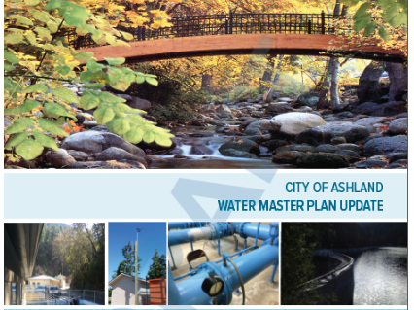
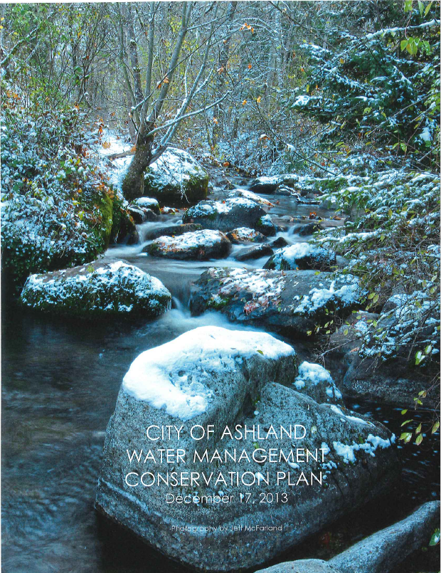
Water System Planning
Ashland Master Plans
  2012 Water Master Plan – Supply Planning
  2020 Water Master Plan
  2020 TAP Master Plan
  2013 Water Management and Conservation Plan
  2023 Water Management and Conservation Plan Update
      Supply Analysis
      Climate Change Impacts
  2022 Regional Water Planning
    Coordinated Water Rights Management
    Water Sharing Plan

Slide 10
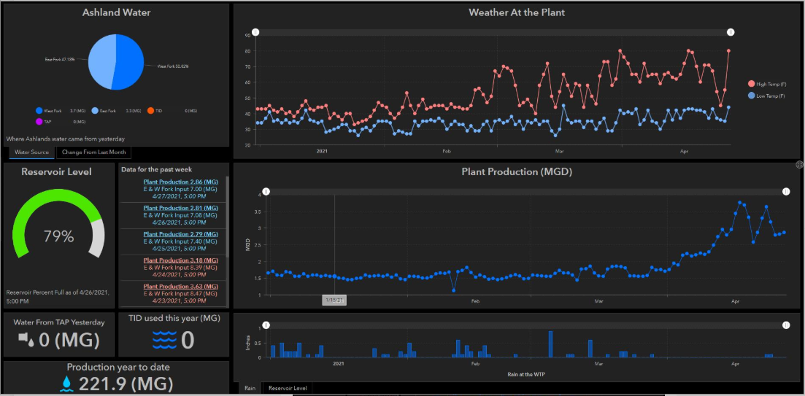
Water Supply 2022 – Dashboard
Comprehensive Water Supply Dashboard
  gis.ashland.or.us/waterusage

Slide 11


Water Conservation & Efficiency
Ashland.or.us/watersupply
Ashlandsaveswater.org

Slide 12


Questions and Discussion?

