Slide 1
Ashland POD’s: Let’s Zoom in!
Multiple vexing values at play in this landscape:
Dry, frequent fire forests highly departed from historic fire regime
Municipal Watershed feeding 20,000 residents + 6,000 students + 350,000 visitors a year.
Late Successional Reserve home to Northern Spotted Owls and Pacific Fisher populations…among other late successional and endemic species.
Highly at-risk community abutted to federal, city and private lands
High dependence on outdoor recreation including mountain biking, running, hiking, birding, and skiing.
Extremely smoke sensitive topography coupled with predominantly retirement age population.
Climate change wreaking all kinds of havoc
Notes:
For Strategic Containment Unit (SCUs) prioritization we averaged housing unit density transmission potential to the POD scale and attributed SCUs with the maximum POD-level value intersected.

Slide 2
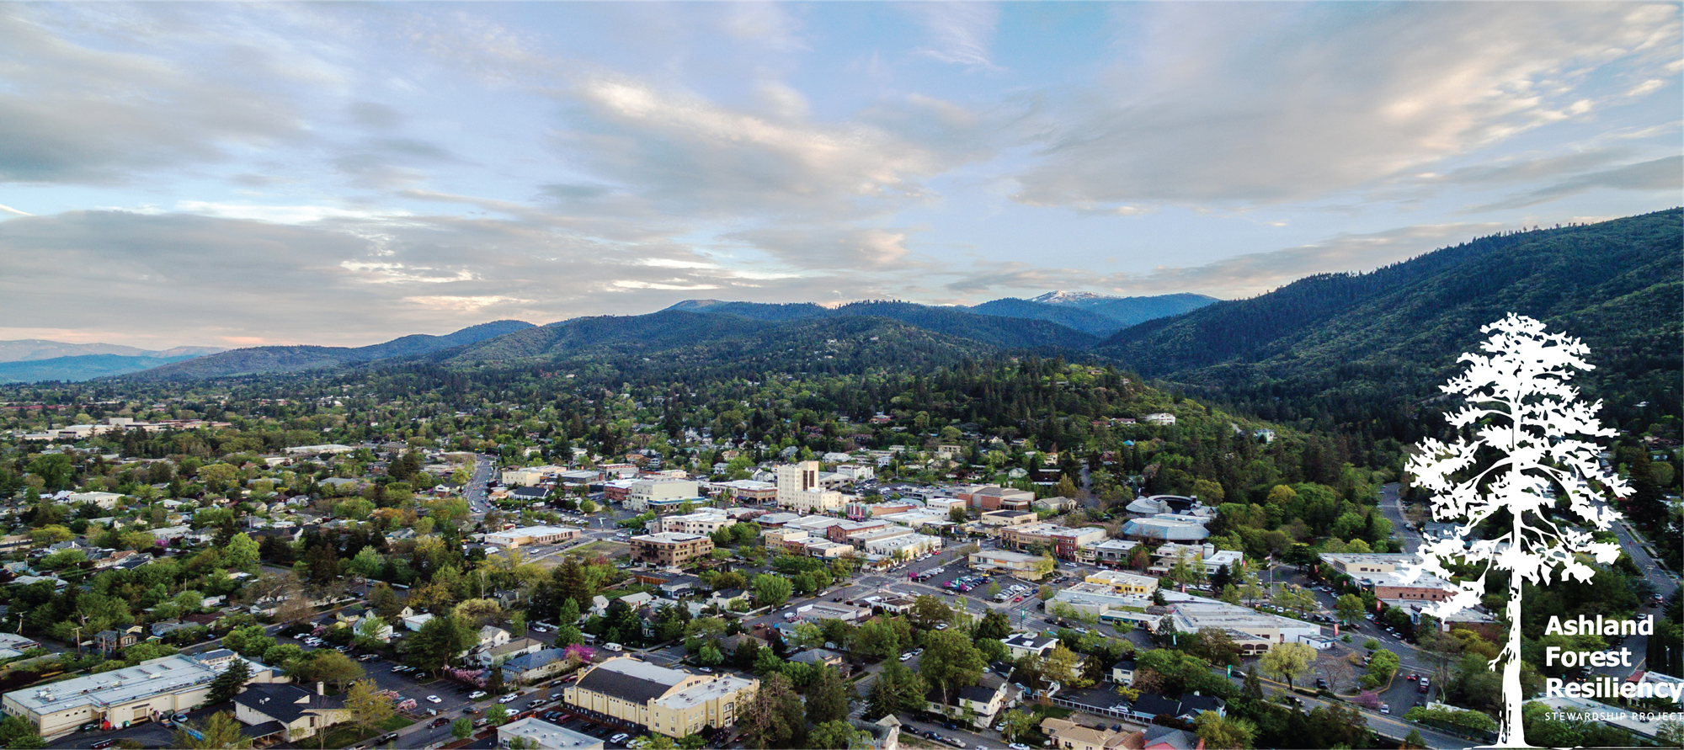
Notes:
For Strategic Containment Unit (SCUs) prioritization we averaged housing unit density transmission potential to the POD scale and attributed SCUs with the maximum POD-level value intersected.

Slide 3
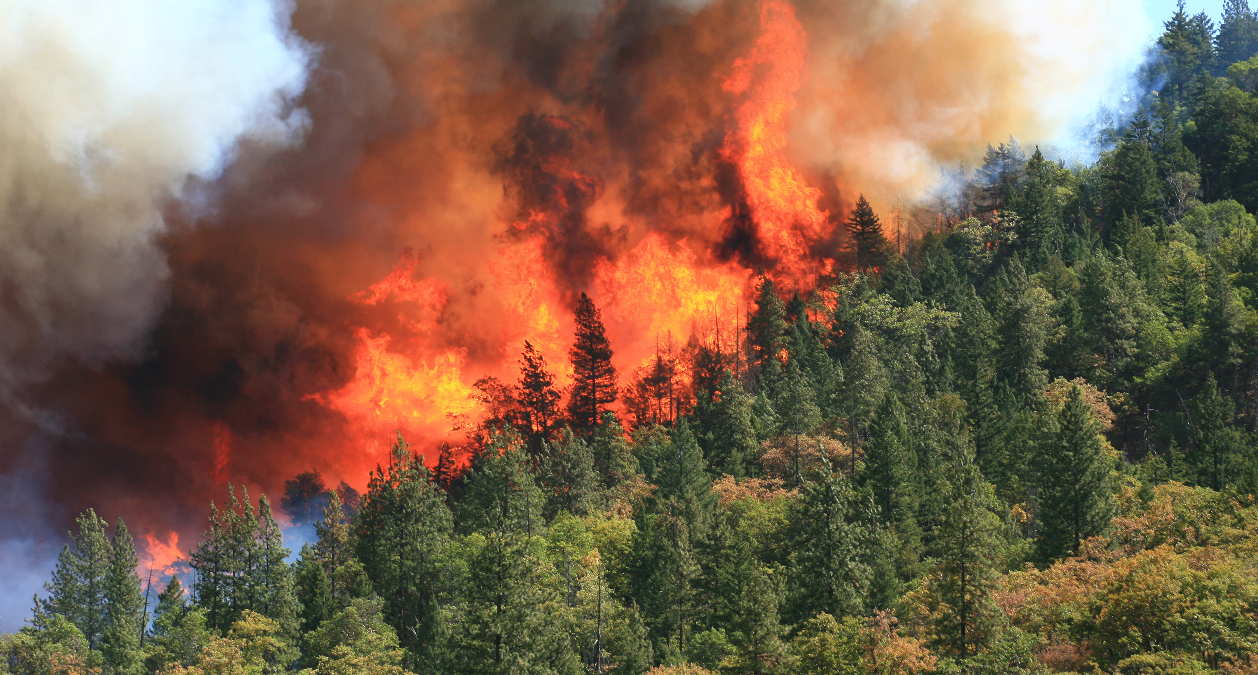
Notes:
For Strategic Containment Unit (SCUs) prioritization we averaged housing unit density transmission potential to the POD scale and attributed SCUs with the maximum POD-level value intersected.

Slide 4
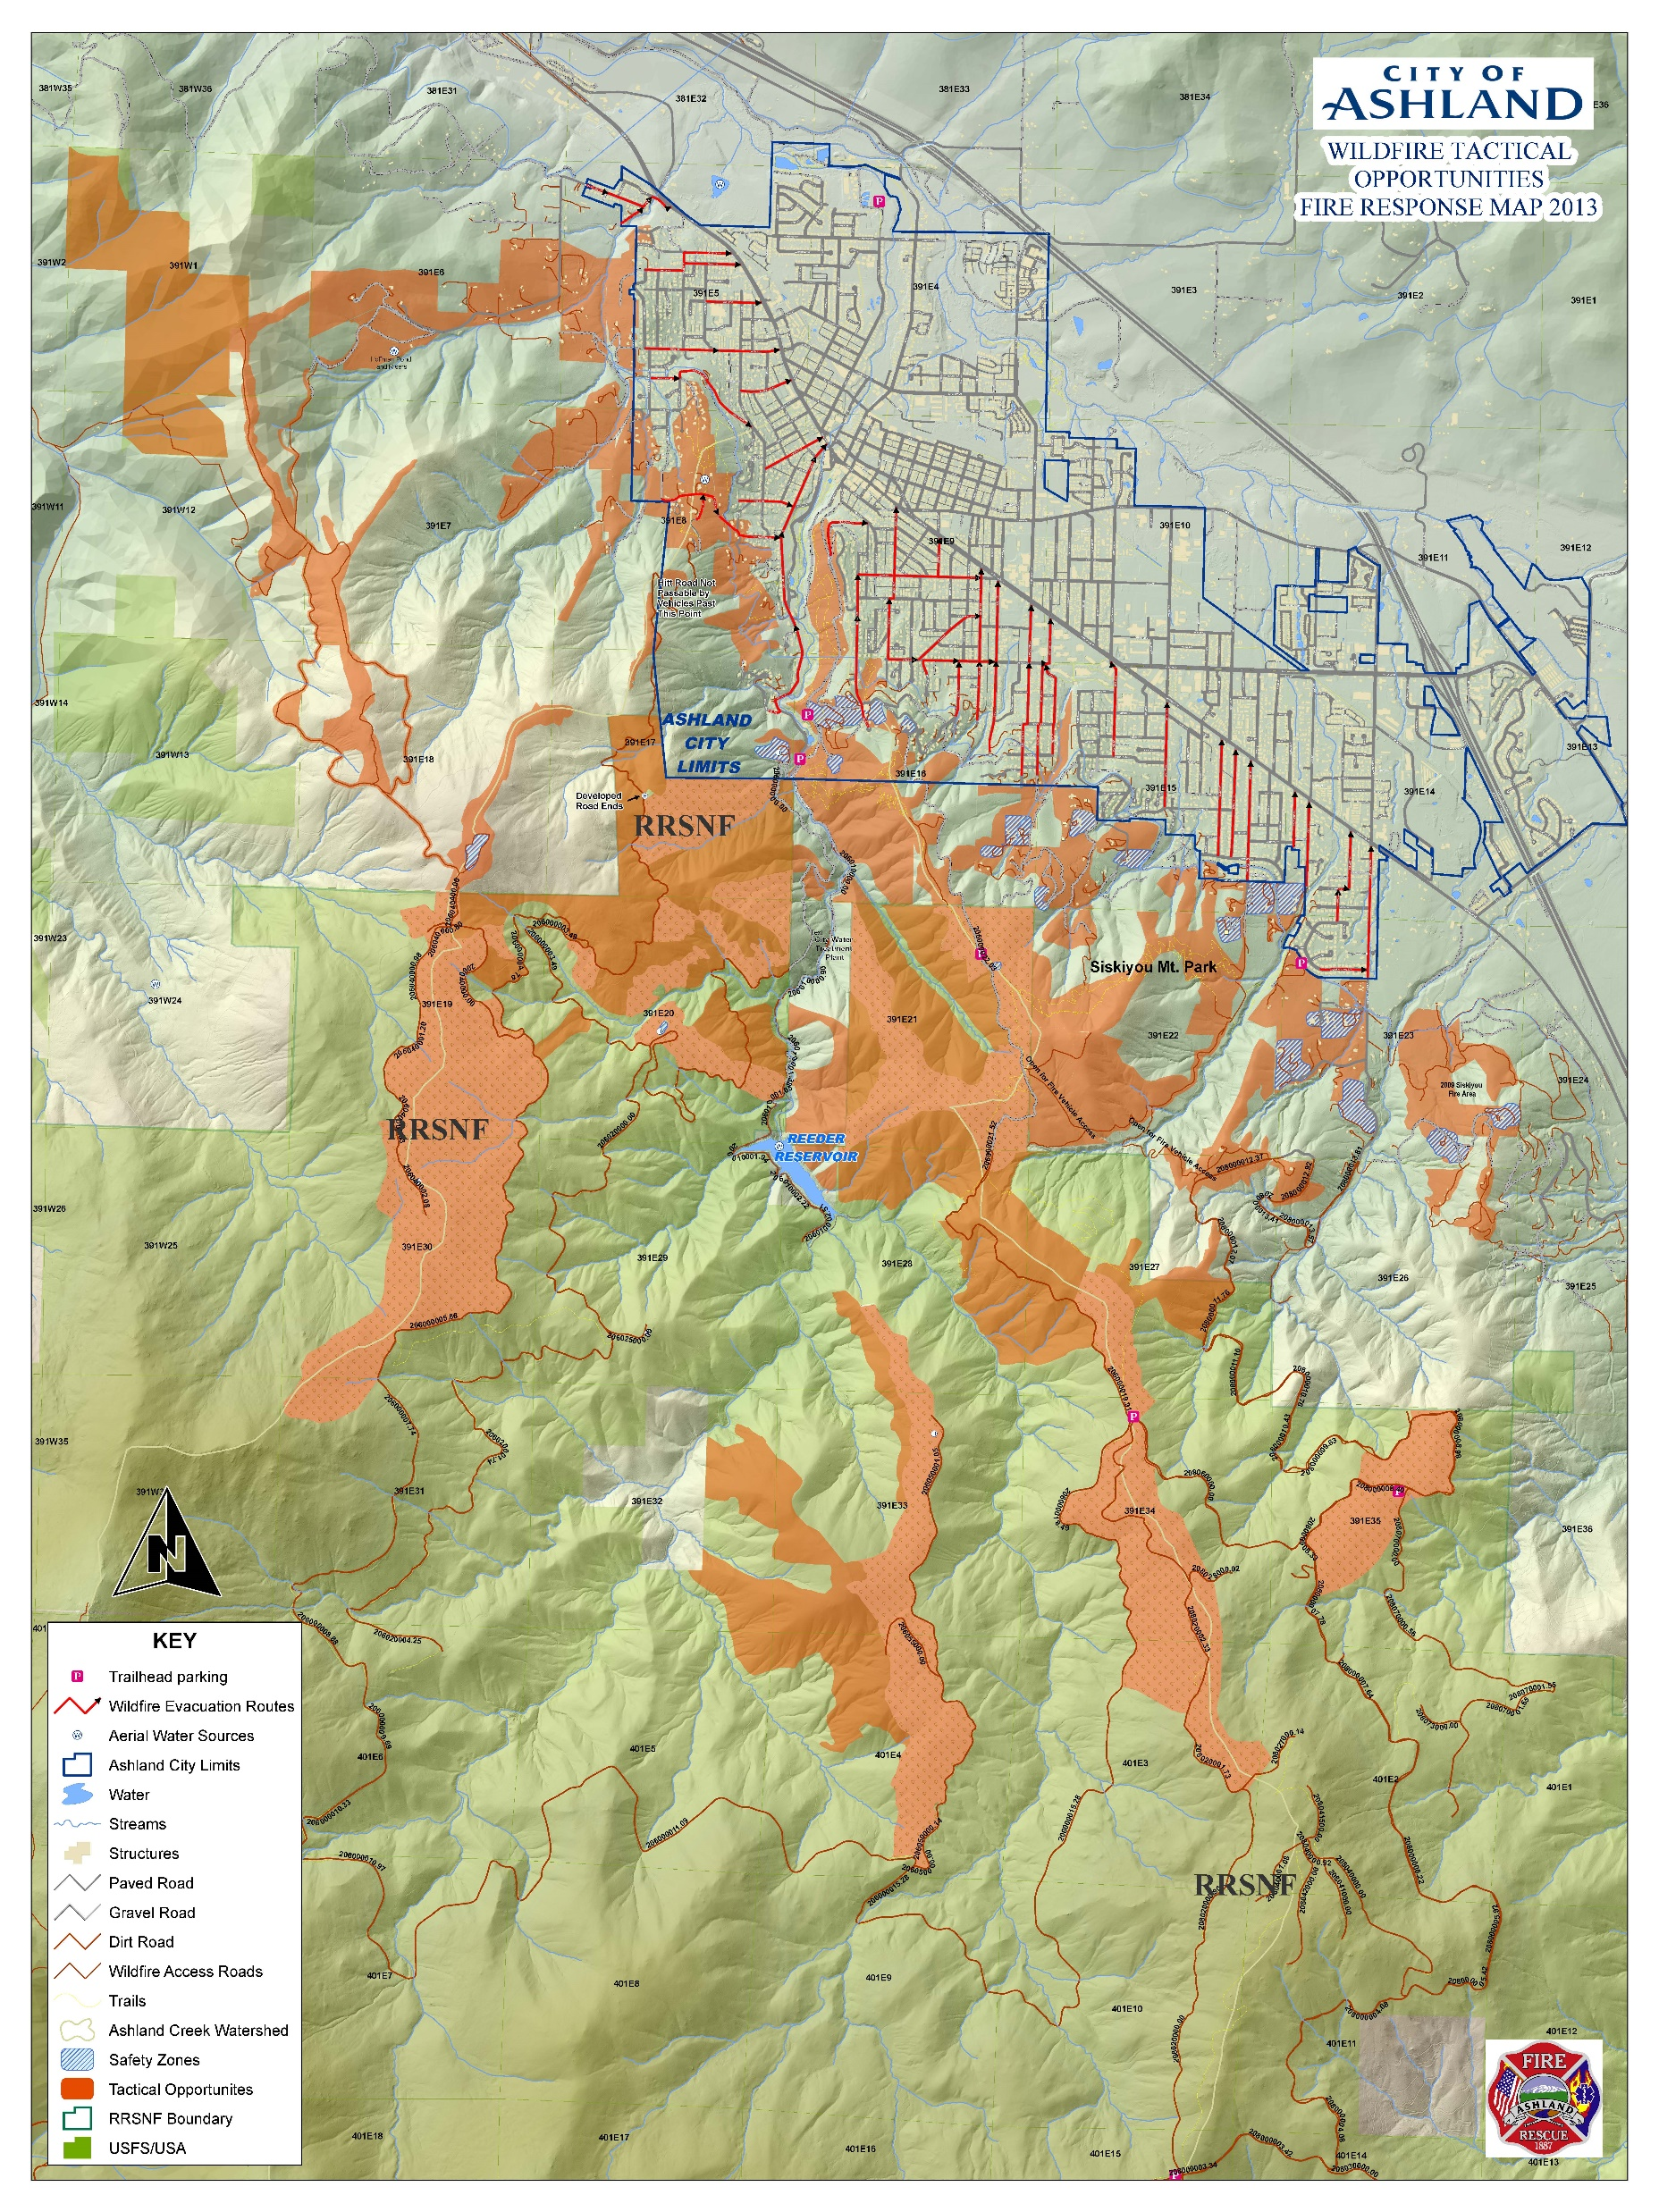

Slide 5
History of Treatments in 52,000 acre Ashland Landscape
City and Ashland Parks since 1990’s = 700 acres
USFS Fuel Breaks and Rx Burning 1980’s = 500 acres
Ashland Watershed Protection Project 2001 = 1,200 acres
Ashland Forest Resiliency Stewardship Project 2004 = 7,500 acres USFS federal
Ashland Forest All-lands Restoration = 4,000 acres private land
12,500 acres under management right now
Notes:
For Strategic Containment Unit (SCUs) prioritization we averaged housing unit density transmission potential to the POD scale and attributed SCUs with the maximum POD-level value intersected.

Slide 7
Community Transmission Analysis
An important objective of wildfire response and risk mitigation activities is to protect communities exposed to wildfire. The R6 QRA is a spatially explicit assessment of wildfire impacts and therefore does not directly address the potential for an ignition to spread into a nearby community.
Here we estimated the potential for wildfire to impact people by summing the housing unit density within each simulated fire perimeters, from the large fire simulator (FSim) results from the Region 6 Quantitative Wildfire Risk Assessment.
Housing unit density is the combined estimate of people living in homes at a point across a landscape.
Based on Microsoft building footprints data and most recent 5-year American Community Survey data from the Census Bureau
Color variation represents a smoothed surface of the number of people impacted by a large wildfire should one ignite and exceed initial attack capabilities within any area across the expanded AFAR landscape
Notes:
For Strategic Containment Unit (SCUs) prioritization we averaged housing unit density transmission potential to the POD scale and attributed SCUs with the maximum POD-level value intersected.

Slide 8
=
Notes:
For Strategic Containment Unit (SCUs) prioritization we averaged ACW watershed transmission probability to the POD scale and attributed SCUs with the maximum POD-level value intersected.

Slide 9
SDI
Strategic Containment Unit
Prioritization
PCL
eNVC
Water
Community
=

Slide 10
Strategic Response Zones (nearly all favor suppression response)

Slide 11
Prioritizing Stands for TREATMENT BURNING!
Prioritization objectives
Protect communities and homes from the negative consequences of wildfire contact.
Enhance climate resiliency of forest stands.
Restore the natural range of variability within stands to pre-EuroAmerican colonization conditions.
Protect Northern Spotted Owl core habitat
Enhance the likelihood of containment success along POD boundaries to improve the likelihood of response success.
Reduce wildfire intensity to minimize consequences to valued resources and assets.

Slide 12
+
=
Strategic Containment Unit
Prioritization
Integrated Values Protected Prioritization
Integrated Likelihood of Success
Notes:
A depiction of the integrated protection objectives and integrated likelihood of success metrics used to create the strategic containment unit prioritization in map three of this series. To place these various metrics on an equivalent scale for prioritization, I did the following:
Each objective/priority metric was normalized between 0 and 1
Then I obtained the geometric mean of those normalized values across all five metrics
Then I normalized the final scale to be between 0 and 1.
This process assumes each metric carries equal weight (weighting is possible). I used the geometric mean to maintain the rank order of the treatment units and general distribution of the data, which were highly skewed.
.

Slide 13
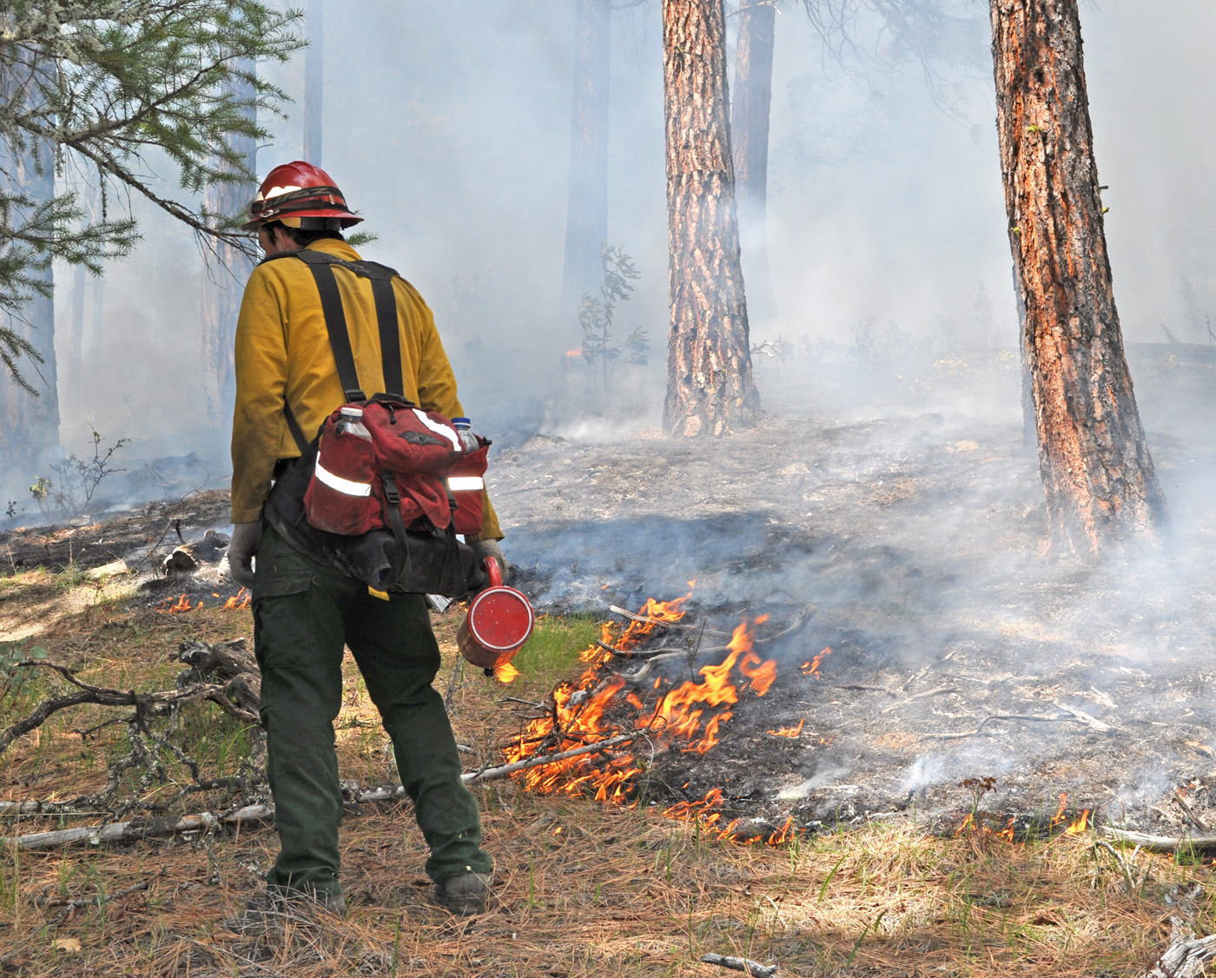
Strategic BURNTAINMENT Units!

